Slide 1
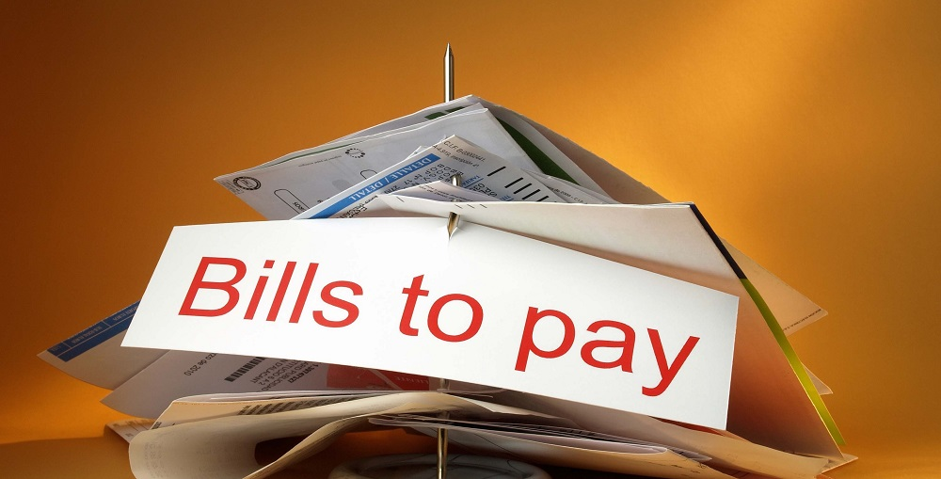
Group Bill Payer
By Sam Lopez, Amber Yeasin, Jaspreet Kaur

Slide 2
Languages
JavaScript
HTML (used for a better layout and easy navigation purposes)
CSS(used for stylistic choices)
mysqli
php

Slide 3
Bill Payer
contains a notifications, bills, payers, receipts, home, and login/logout features
automatically will generate receipts
drop down menu so you can go from any view at any time
uniqueness of user identified with email
divides bills with other group mates
sends notifications for bills due

Slide 4
Responsibilities
Sam | Jaspreet | Amber
use case diagram state diagram gantt chart scrum artifacts setting up sql/php files backend of sql | use case diagram state diagram Presentation class diagram gantt chart scrum artifacts HTML pages | use case diagram state diagram class diagram gantt chart scrum artifacts HTML pages documentation

Slide 5
Problems
Time management
Integrating everything together so all the views were working
Debugging sql problems
Getting everything prepared for project 4 and making a good mid way point for project 3

Slide 6
Retrospective for Project 4
Want to have good stylistic html pages finished
Make sure each functionality in our scrum artifacts is fulfilled
Incorporate a group chat
Incorporate a bill scanner
Maybe turn it into an app

Slide 7
Works Cited
References to stackoverflow.com
References to w3schools.com
sql lab 5
http://www.debtwave.org/blog/juggling-your-monthly-bills-on-a-bi-weekly-pay-schedule/ image on title page

